Slide 1
GURUDEEP SWASANEKAR P

Slide 2
Generative AI Art Installation - Creating Dynamic and Interactive Art Experiences

Slide 3


AGENDA
Introduction to Generative AI in Art Installations
Problem Statement: Traditional vs. Generative Art Installations
Project Overview: Design and Implementation
End Users: Target Audience and Engagement
Solution and Value Proposition
The "Wow" Factor in the Solution
Modeling: Techniques and Algorithms
Results and Impact
3/21/2024 Annual Review

Slide 4

PROBLEM STATEMENT
Within the realm of art installations, a common challenge arises in captivating audiences with experiences that are both dynamic and interactive. Traditional static displays often fall short in fostering deep engagement among viewers. This initiative addresses this challenge by pioneering innovative approaches that seamlessly integrate artistic expression with state-of-the-art technology, thereby creating immersive and interactive experiences that resonate deeply with audiences.

Slide 5

PROJECT OVERVIEW
The generative AI art installation represents a pioneering endeavor to bridge the gap between traditional artistic mediums and computational methodologies. By harnessing the capabilities of generative algorithms, the project endeavors to produce artworks that are not only visually compelling but also responsive to real-time interactions from viewers. Through a meticulously curated fusion of visual and auditory elements, the installation aims to craft a multisensory experience that transcends the confines of conventional art forms, inviting participants on a journey of exploration and self-discovery.

Slide 6

WHO ARE THE END USERS?
The target demographic for the generative AI art installation is diverse and inclusive, encompassing art enthusiasts, museum-goers, technophiles, and the general public alike. The installation is thoughtfully designed to cater to individuals of all ages and backgrounds, fostering a sense of curiosity, wonder, and engagement among participants, irrespective of their prior exposure to art or technology.

Slide 7

YOUR SOLUTION AND ITS VALUE PROPOSITION
The proposed solution revolves around the development of an art installation that leverages the transformative potential of generative AI algorithms to create immersive and interactive experiences. By seamlessly integrating AI technology into the creative process, the project aims to unlock novel avenues for artistic expression and audience engagement. The installation's value proposition lies in its ability to offer participants a deeply personalized and transformative encounter with art, blurring the boundaries between the physical and the digital realms.

Slide 8

THE WOW IN YOUR SOLUTION
The inherent "wow" factor of our solution lies in its seamless fusion of generative AI technology with traditional art forms, culminating in a truly immersive and captivating experience for viewers. From dynamically evolving visuals to responsive interactions, the installation beckons participants to embark on a journey of exploration and introspection, leaving a lasting imprint on their psyche long after their encounter with the artwork.
3/21/2024 Annual Review
8

Slide 9
MODELLING
The modeling phase of the project encompasses the meticulous development and refinement of generative AI algorithms tailored to produce visually stunning and dynamically evolving artwork. Drawing upon a diverse array of techniques such as neural style transfer, generative adversarial networks (GANs), and recurrent neural networks (RNNs), the modeling endeavor endeavors to push the boundaries of creativity and innovation in art, paving the way for groundbreaking artistic expressions.
9

Slide 10
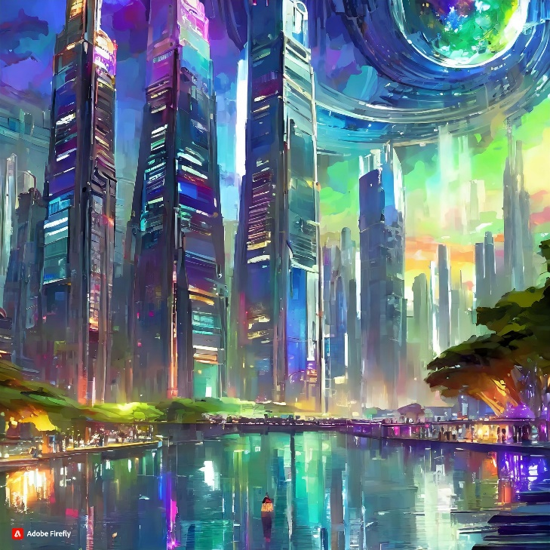
RESULTS
The culmination of the generative AI art installation is a mesmerizing and transformative experience that transcends conventional artistic paradigms, leaving audiences spellbound and enriched. Participants are beckoned to immerse themselves in a realm where the boundaries between art and technology dissolve, and the possibilities are as limitless as the depths of human imagination. Ultimately, the installation serves as a poignant testament to the profound impact of creativity and innovation in shaping our perceptions of the world around us.
10

